Slide 1
Engaging History Tool
George Clarke

Slide 2
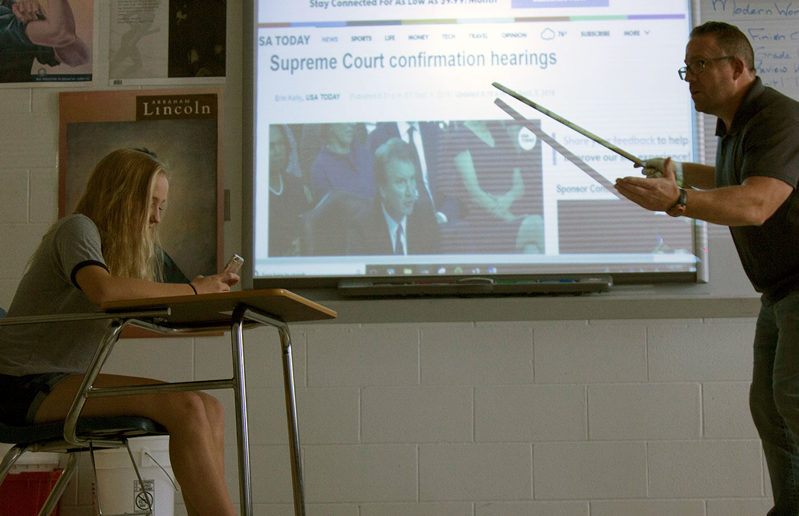
Problem: lack of historical interest
“History has never been so unpopular” – Ofsted report 2011
Particularly the younger generation are not interested
Students may have no knowledge of their university and the city
Notes:
“Statement” –Ofsted 2011, history British schools
Younger generation particularly not interested
Uni students may not know anything

Slide 3
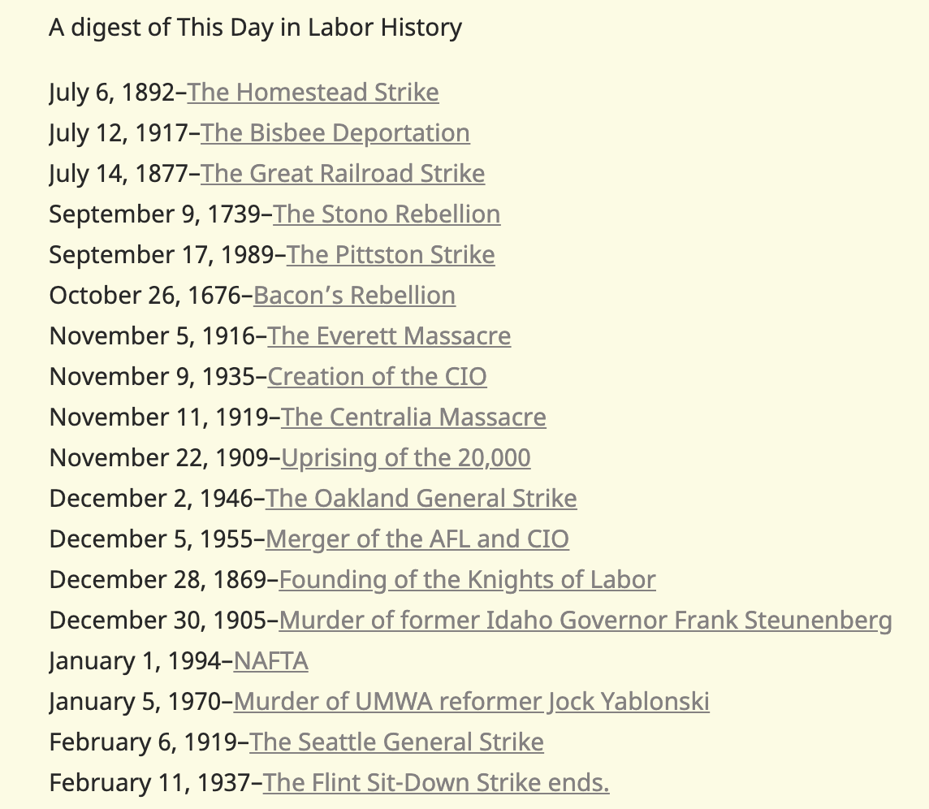
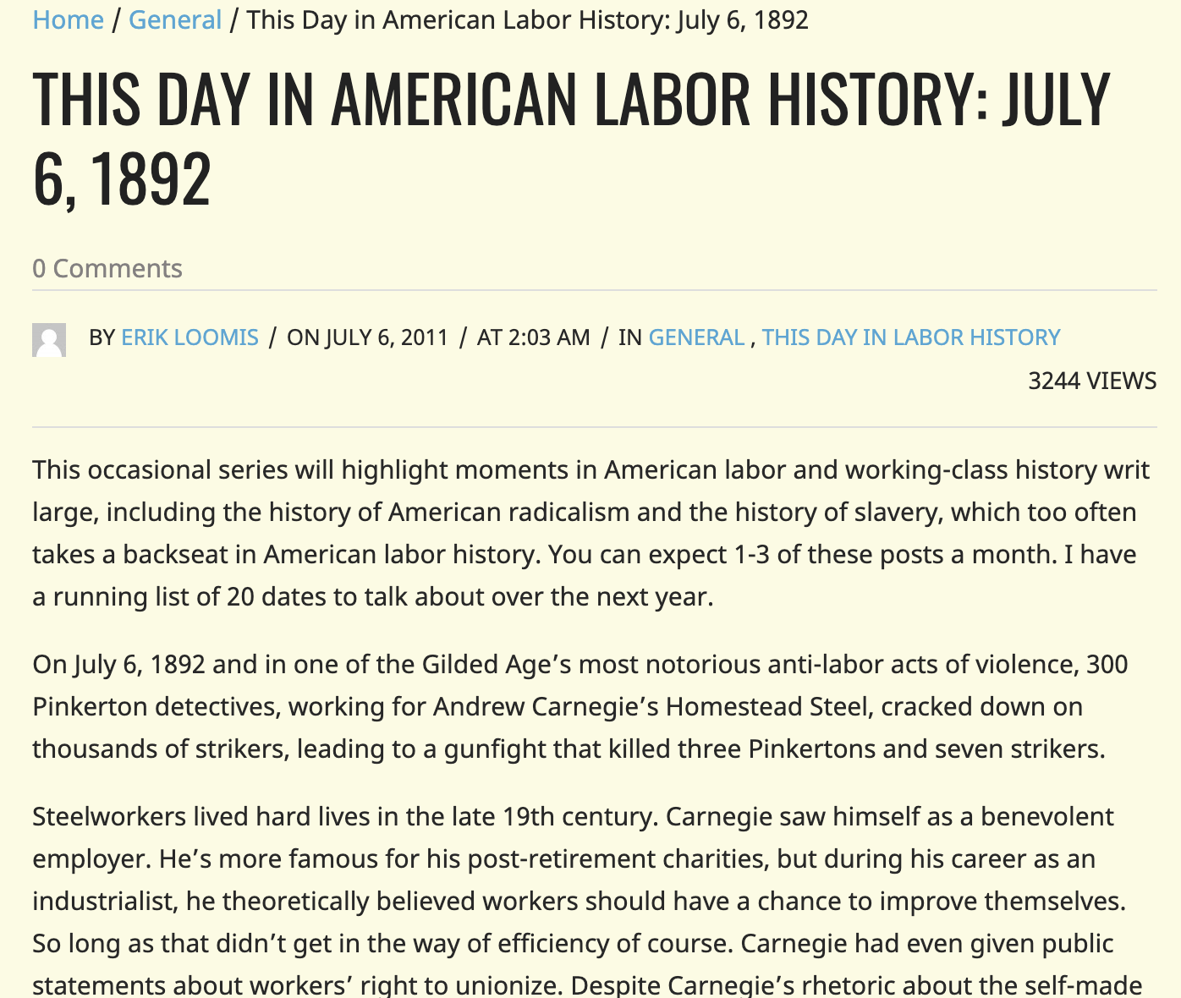
Why the lack of interest?
Corpus’ and blogs/articles not interactive
Boring
Current blog - People read new blog posts but never read older ones
Index of over 300 blog posts
Notes:
Current tools not interactive – boring
Example labour history, read new posts
Don’t read the index of 300+ articles

Slide 4
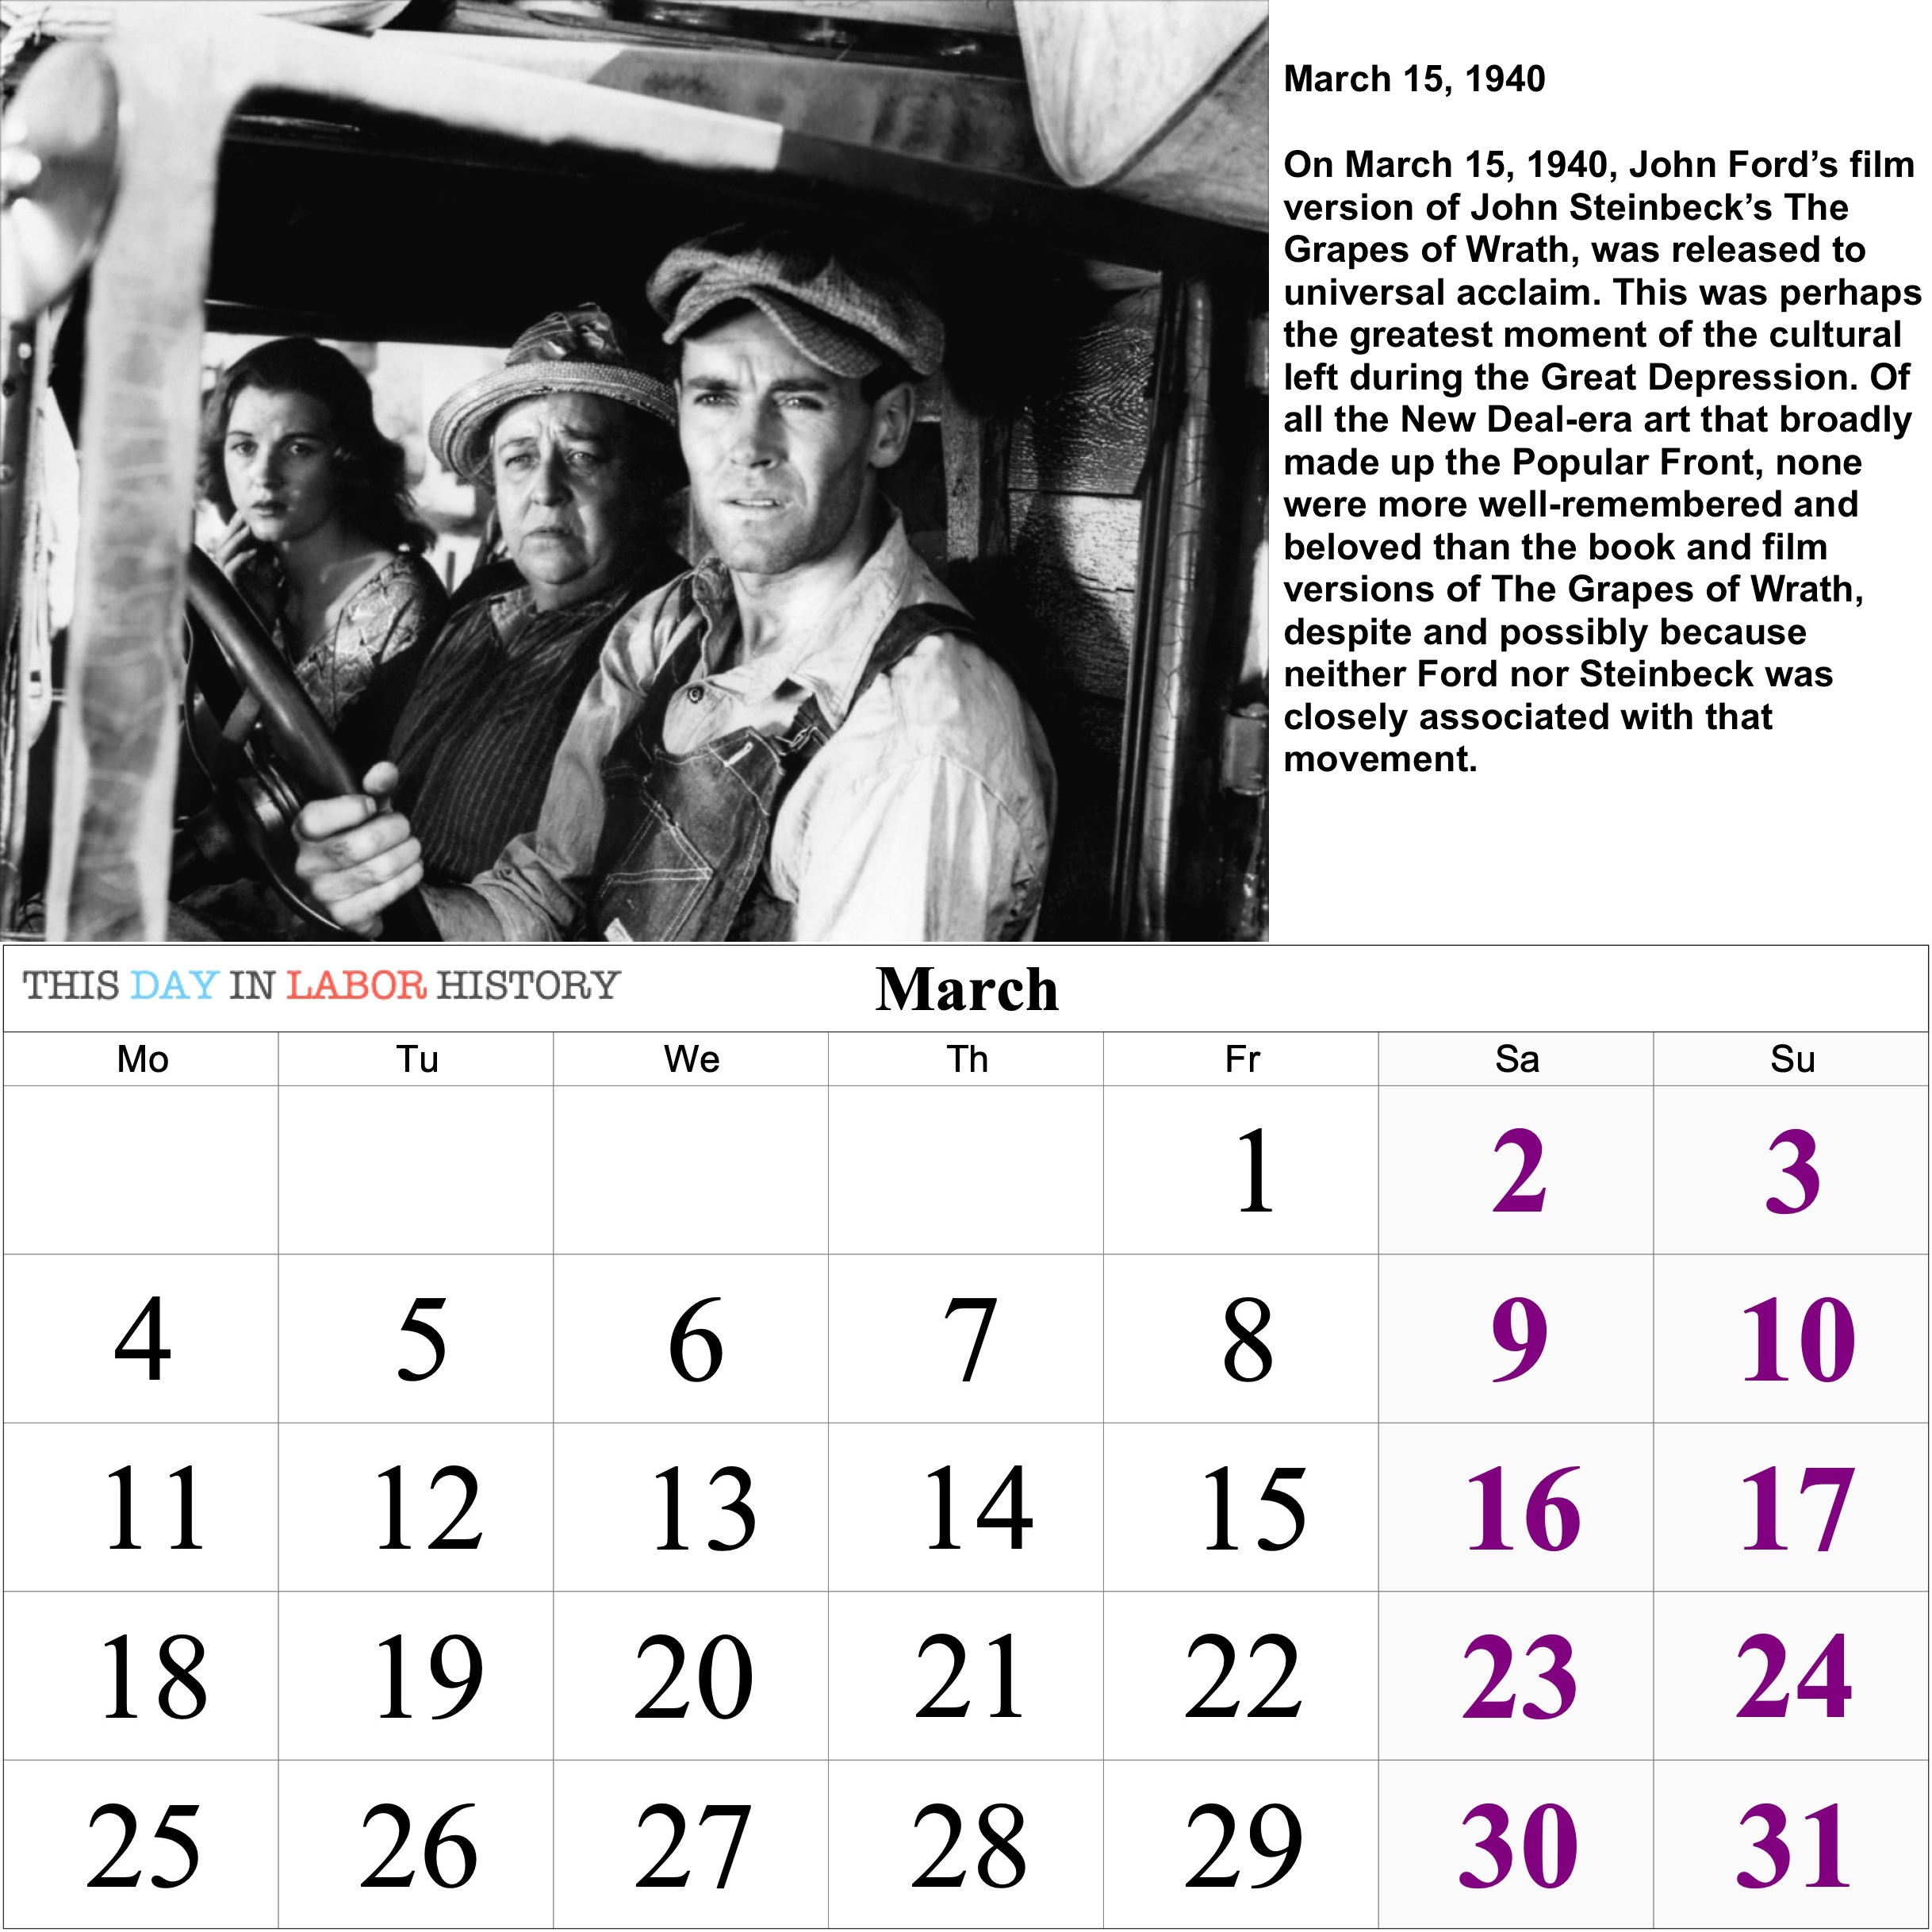
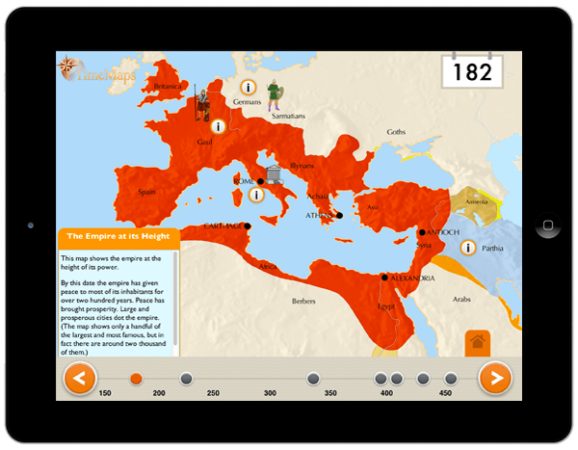
Interaction
Attractive Physical Artefact
Digital Destination
Scan QR code
Directed to web-page
Notes:
Change this, make a corpus engaging and interesting
Plan: attractive physical artefact
Enticed by QR code
Takes to digital destination, explore, engaged

Slide 5
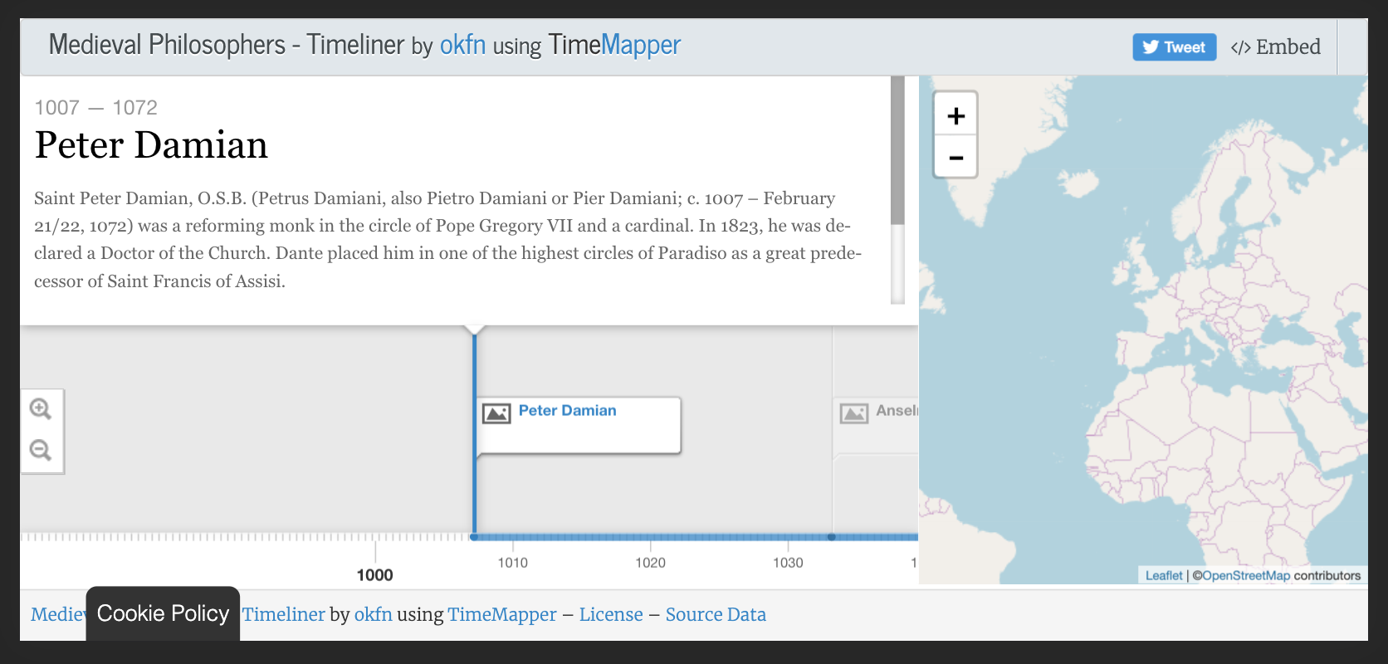
Calendar and Time-Map
Calendar creation tool written in Python using the callirhoe framework
One historical event for each month
Will also contain useful information (School calendar etc.)
QR code directs user to a time-map
Notes:
Physical – calendar
Creation using python and callirhoe
Each month an event, picture, description
Useful info for students (school calendar) – ensures daily use
Eventually scan QR code to time-map
Shows current, then explore, much better than an article as keeps engagement

Slide 6

Corpus
Self built corpus containing all the historical information
Mixture of University history and Manchester history
Plan to be given to new university students
Notes:
Self made corpus
Uni and Manchester history
Give to students – more interested and excited about attending uni

Slide 7
Project Plan
Month | Plan
November | First Created Calendar
December | Finish the Time-Map and Corpus
January | Exams
February | Finalise and Complete Project
March | Evaluation
April | Evaluation
Organisation:
Trello – organisation of tasks
Git – version control
Notes:
End of month first calendar
Time-map and corpus complete end of December
After exams and Feb finalise and complete
March and April evaluation – large part of my project

Slide 8
Evaluation
Need to spend a lot of time on the evaluation
Hand out prototype calendars to some students
Want to measure how engaging the project is:
Track click-through usage from the QR codes being scanned using bit.ly
Create surveys for the students to answer
Notes:
Evaluation large part– a lot of time
Handing to students
Measure engagement
Track click-through QR - bit.ly
Surveys and ask opinion better understand success

Slide 9
Thank You
Thank you for listening! I will happily answer any questions.

